Slide 1
Works
1
Literature comparison
2
Write Introduction part of thesis

Slide 2
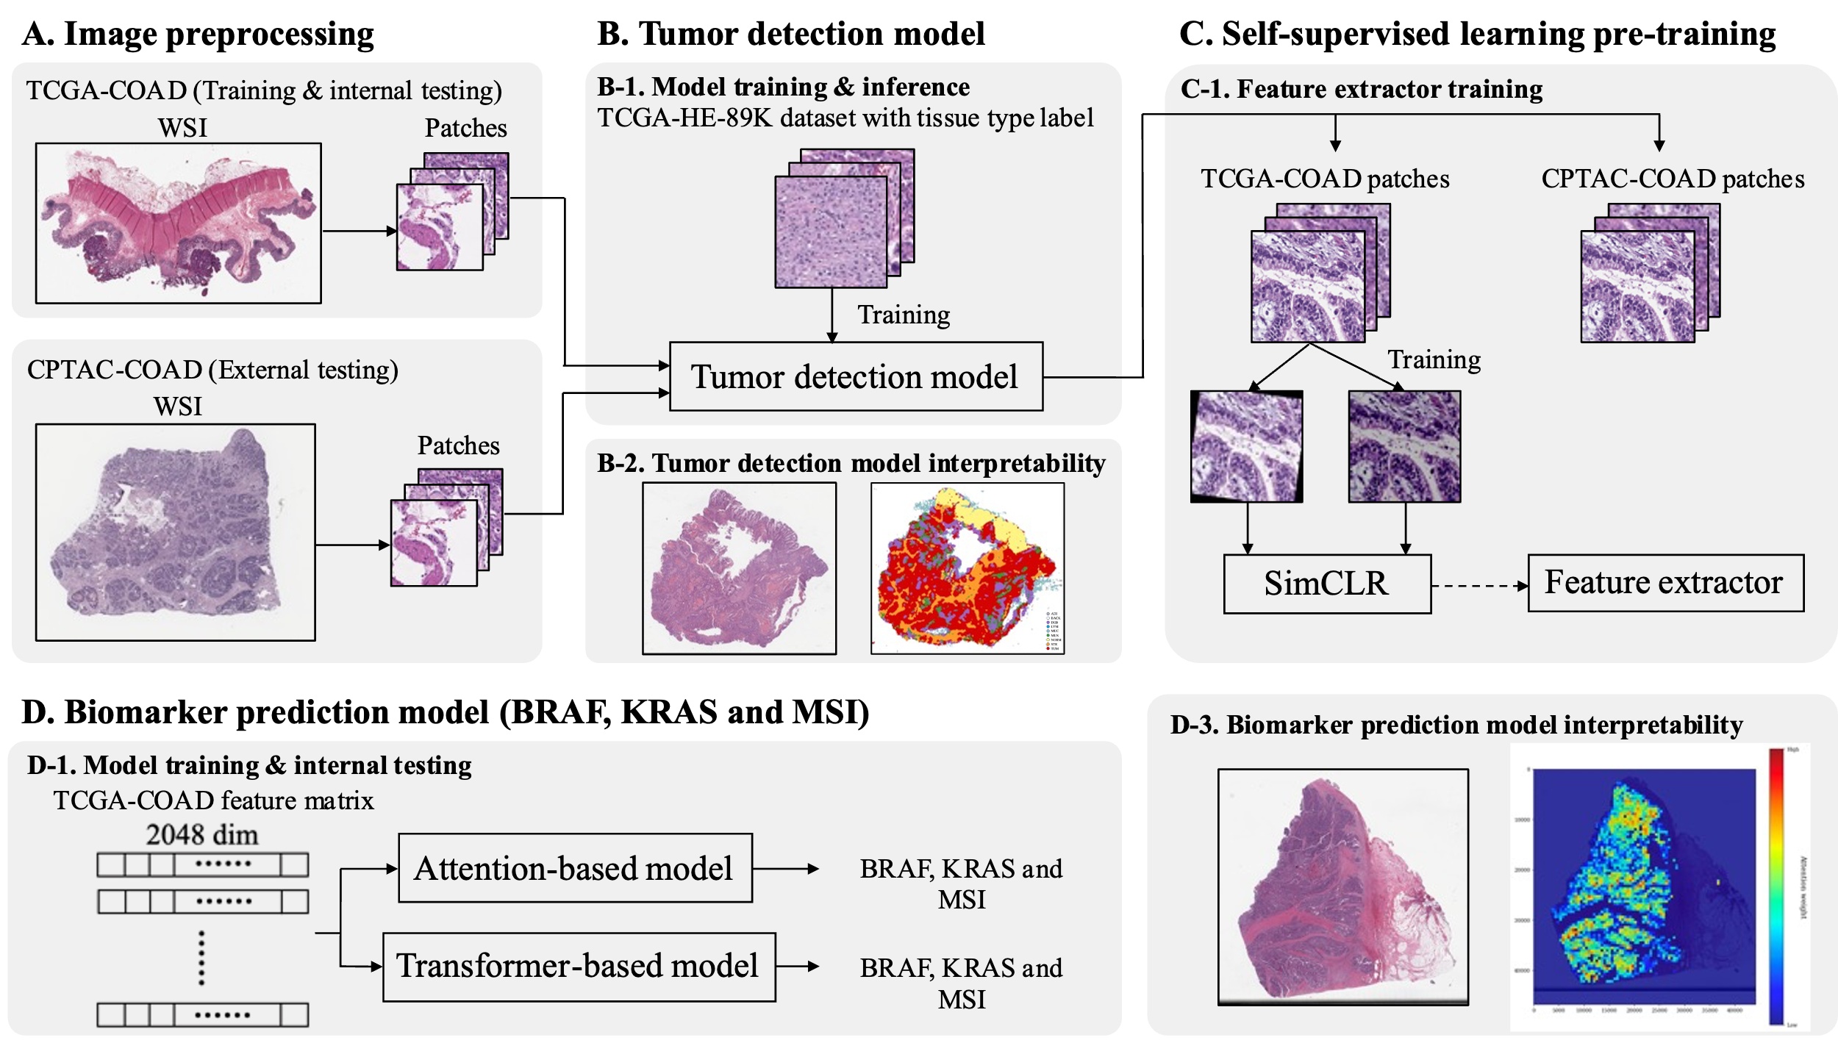

Slide 3
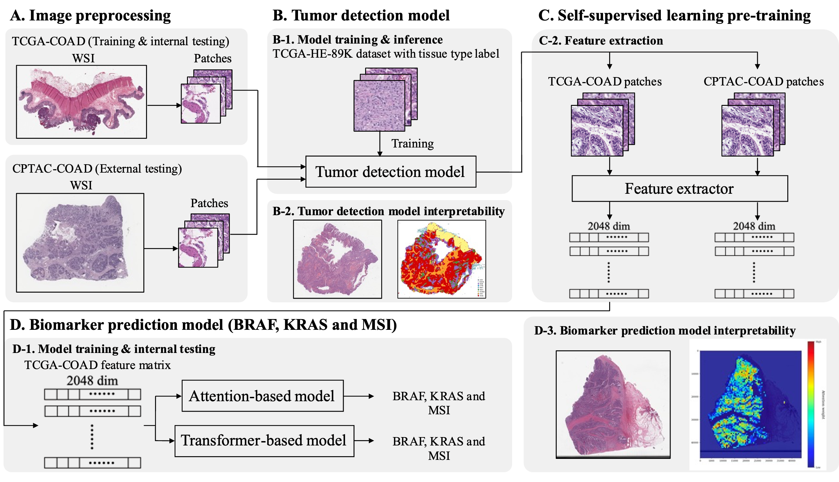

Slide 4
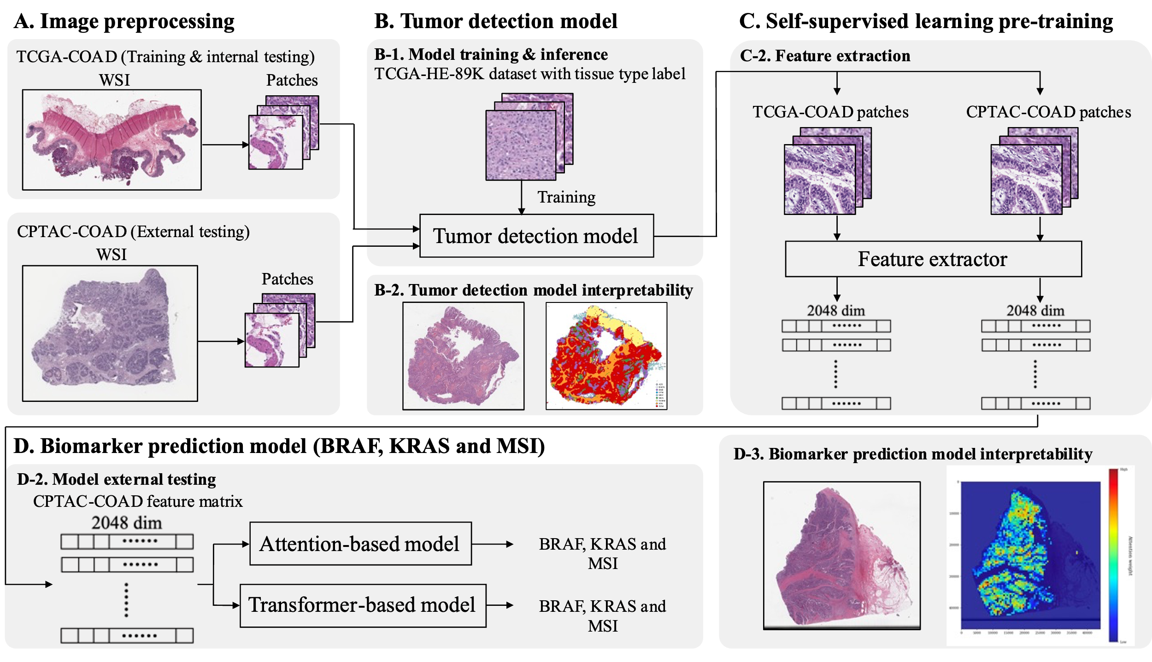

Slide 5
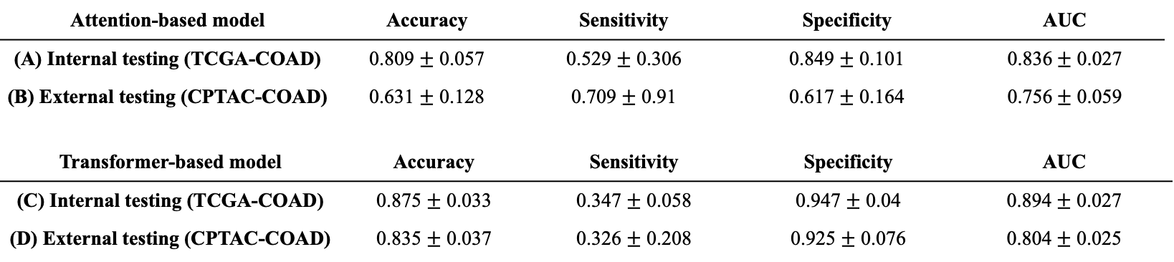
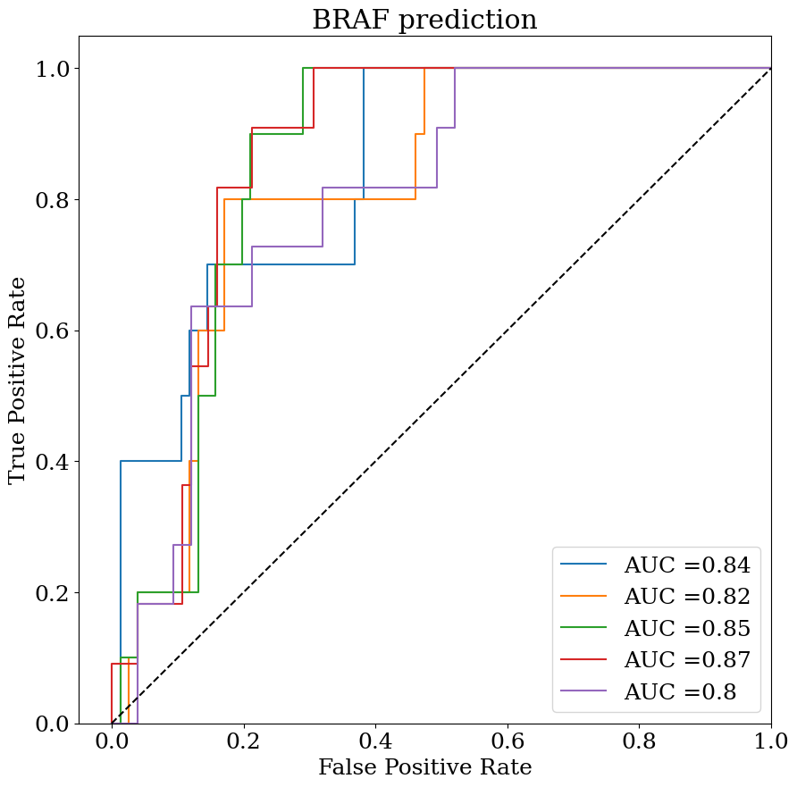
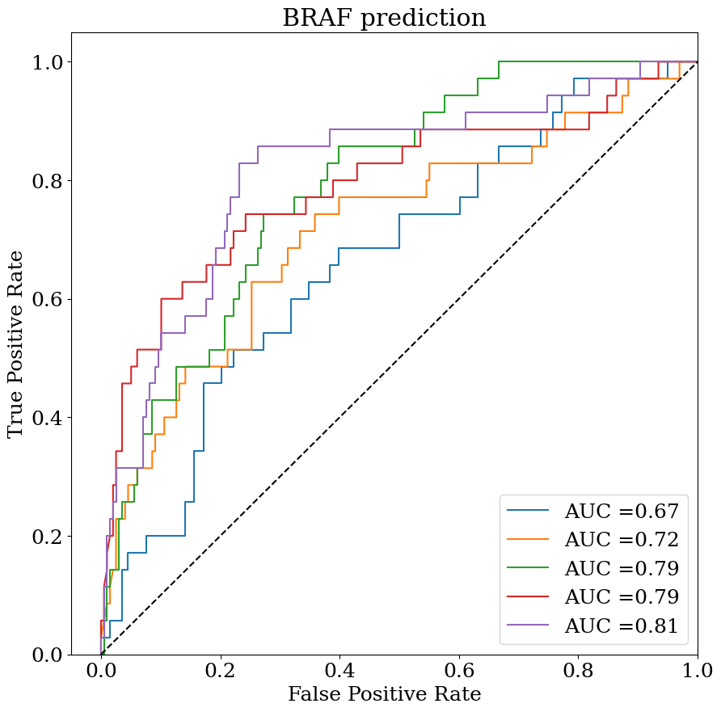
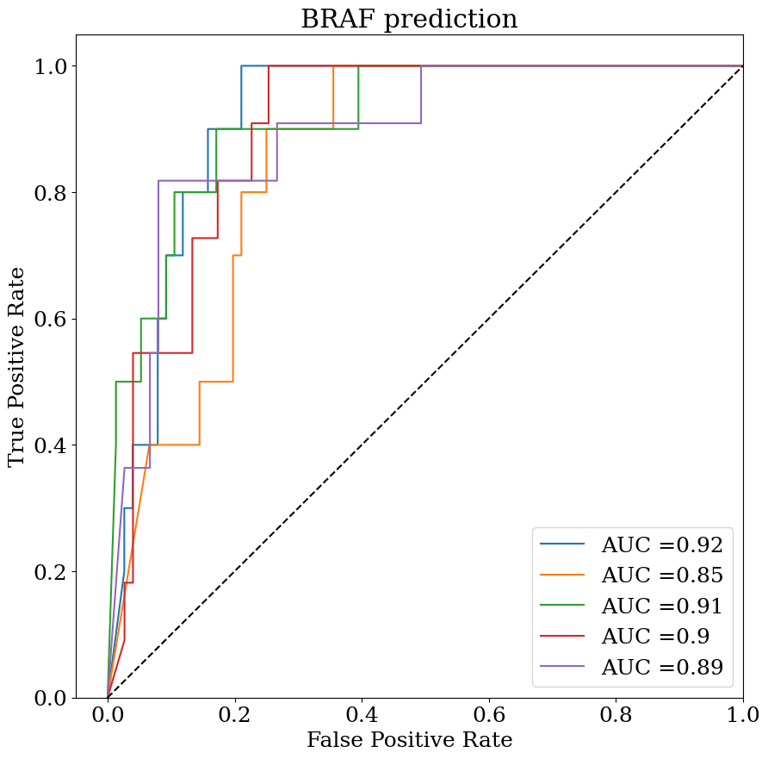
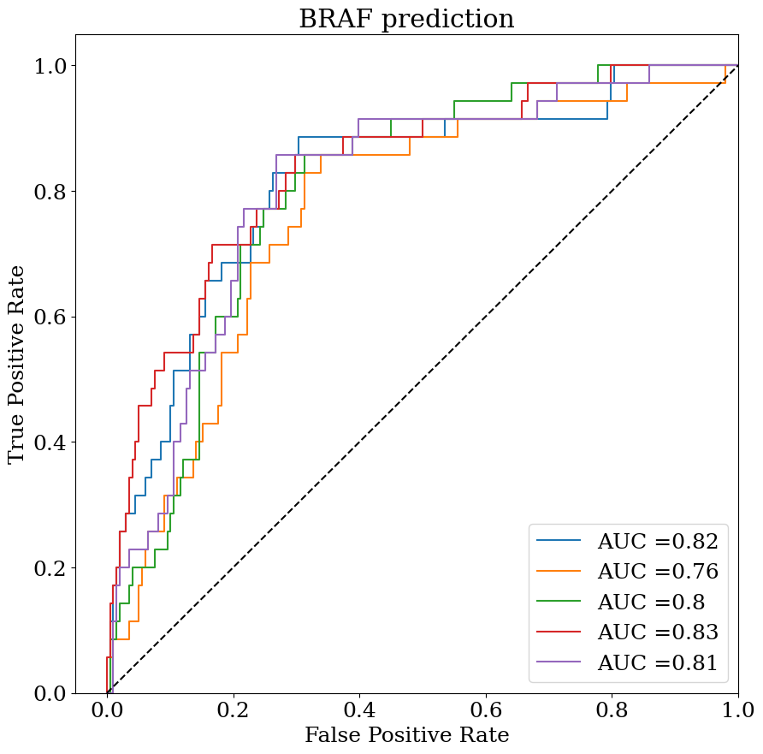
BRAF prediction (Our results)
(A)
(B)
(C)
(D)

Slide 6

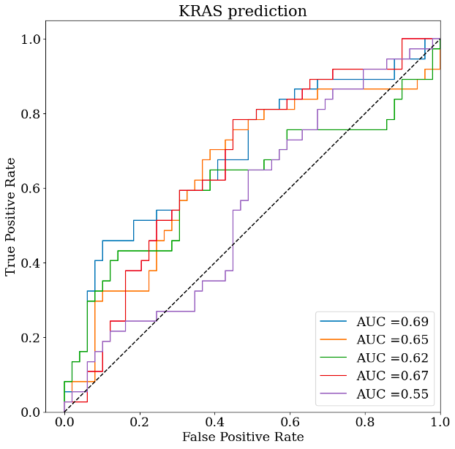
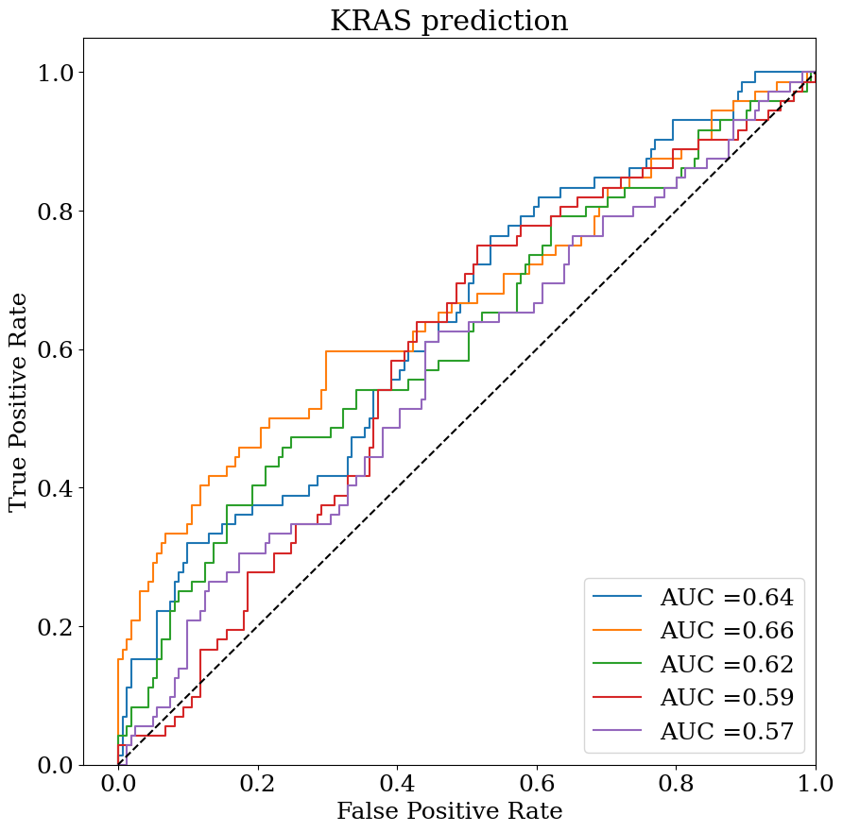
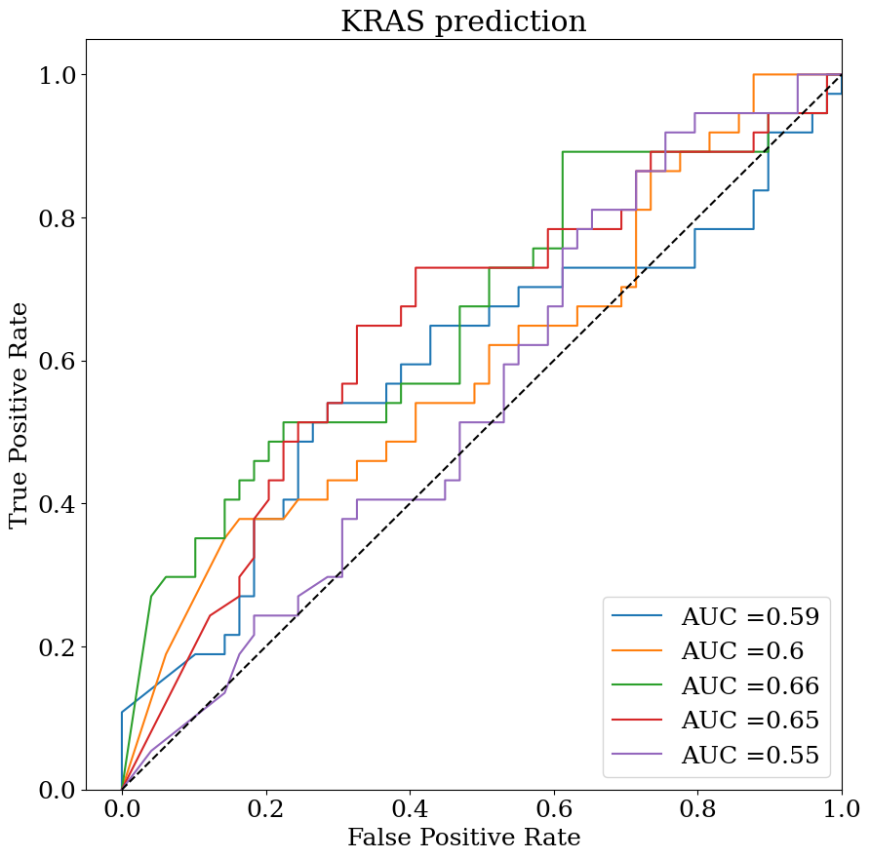
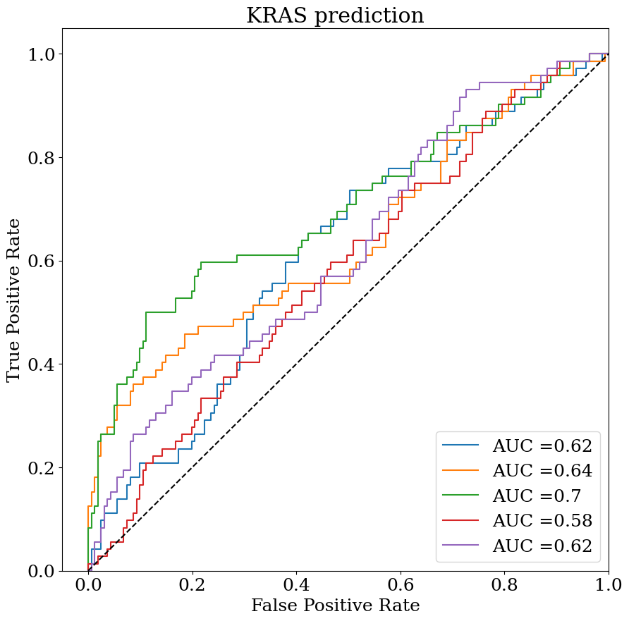
KRAS prediction (Our results)
(A)
(B)
(C)
(D)

Slide 7

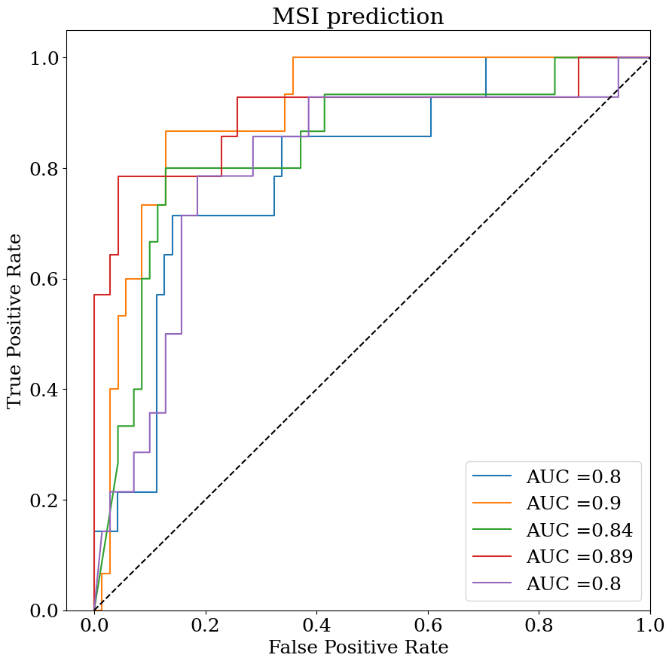
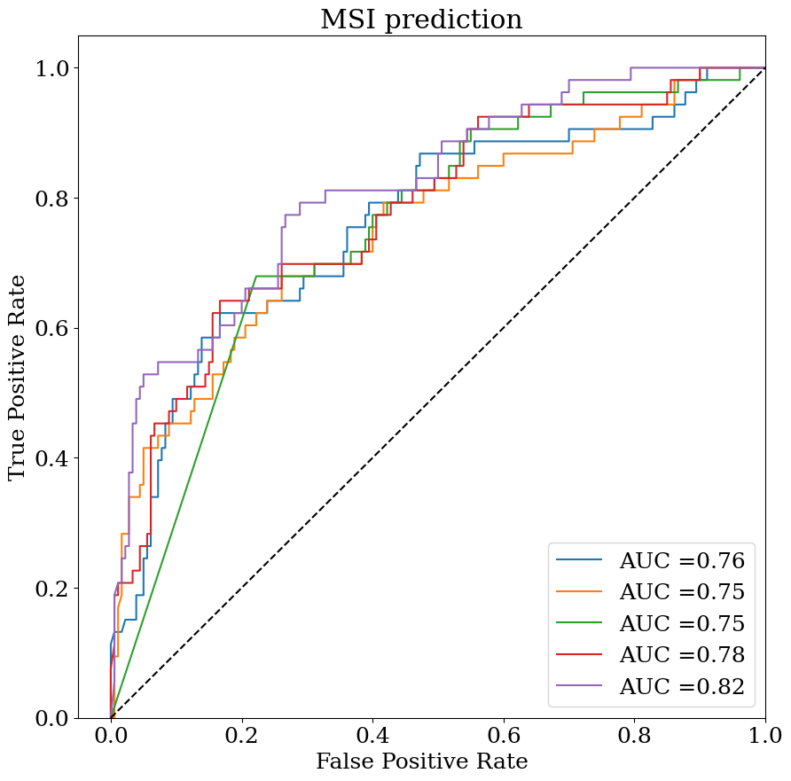
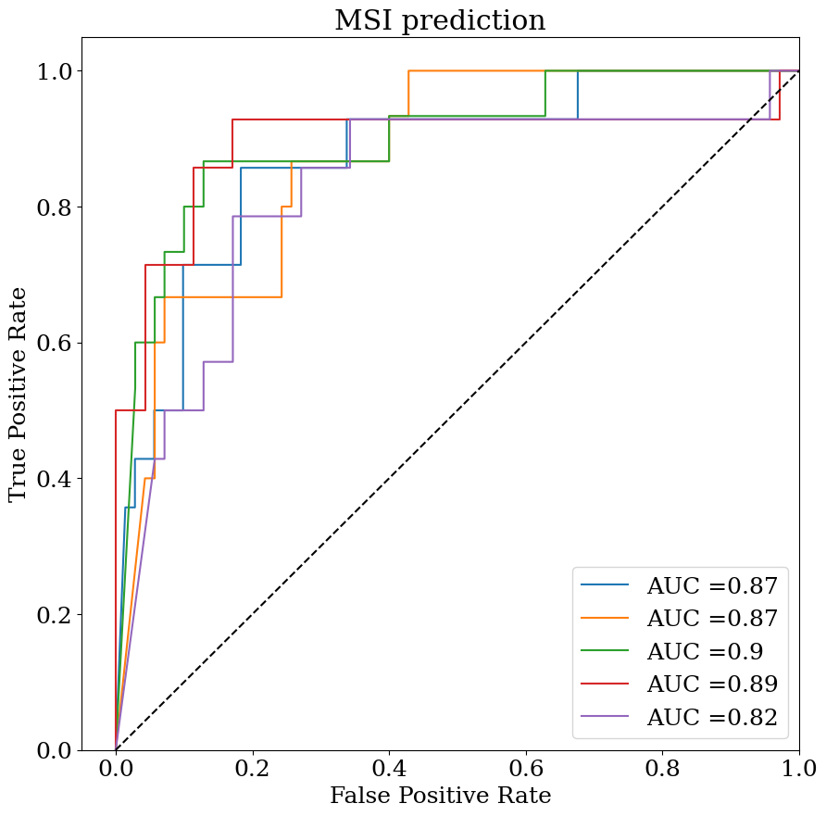
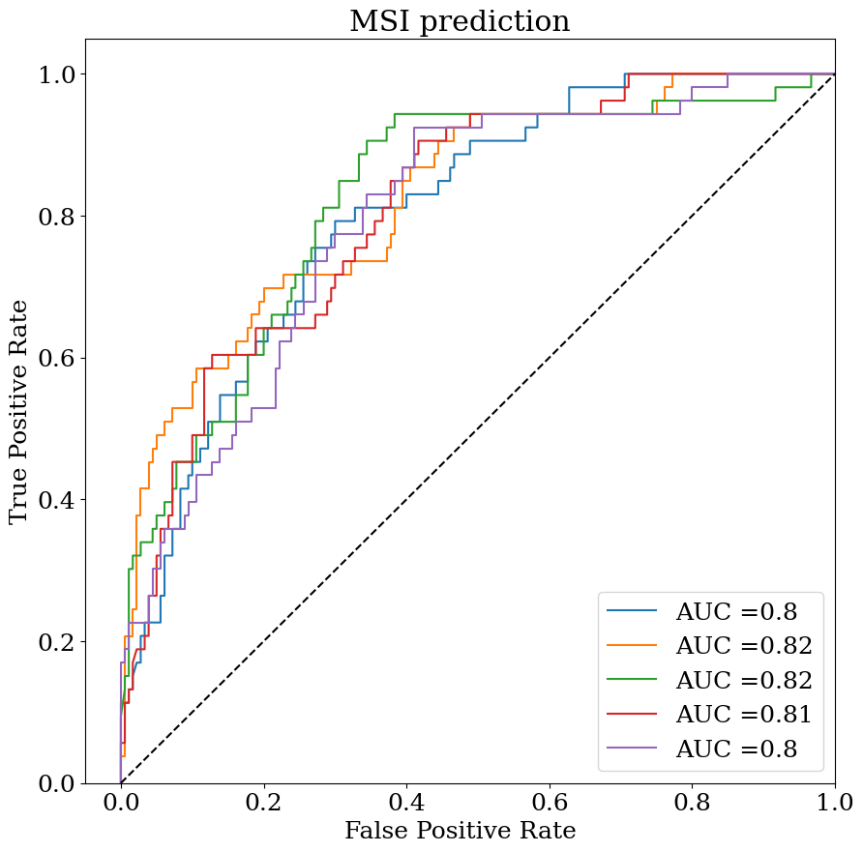
MSI prediction (Our results)
(A)
(B)
(C)
(D)

Slide 8
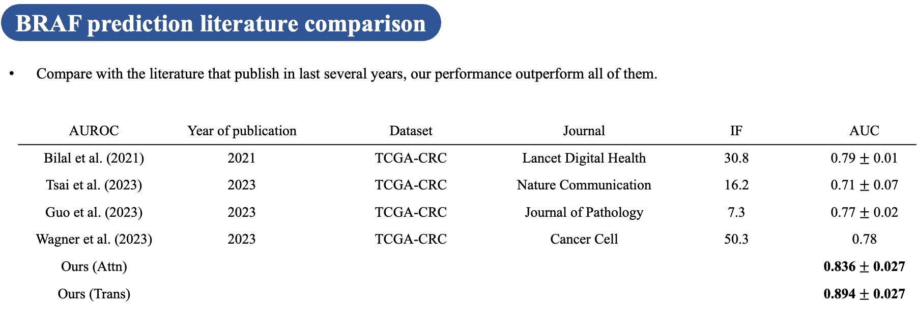

Slide 9
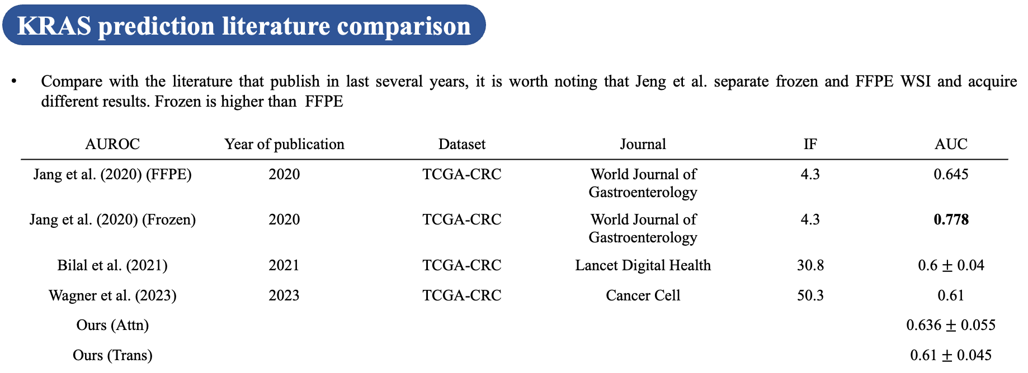

Slide 10
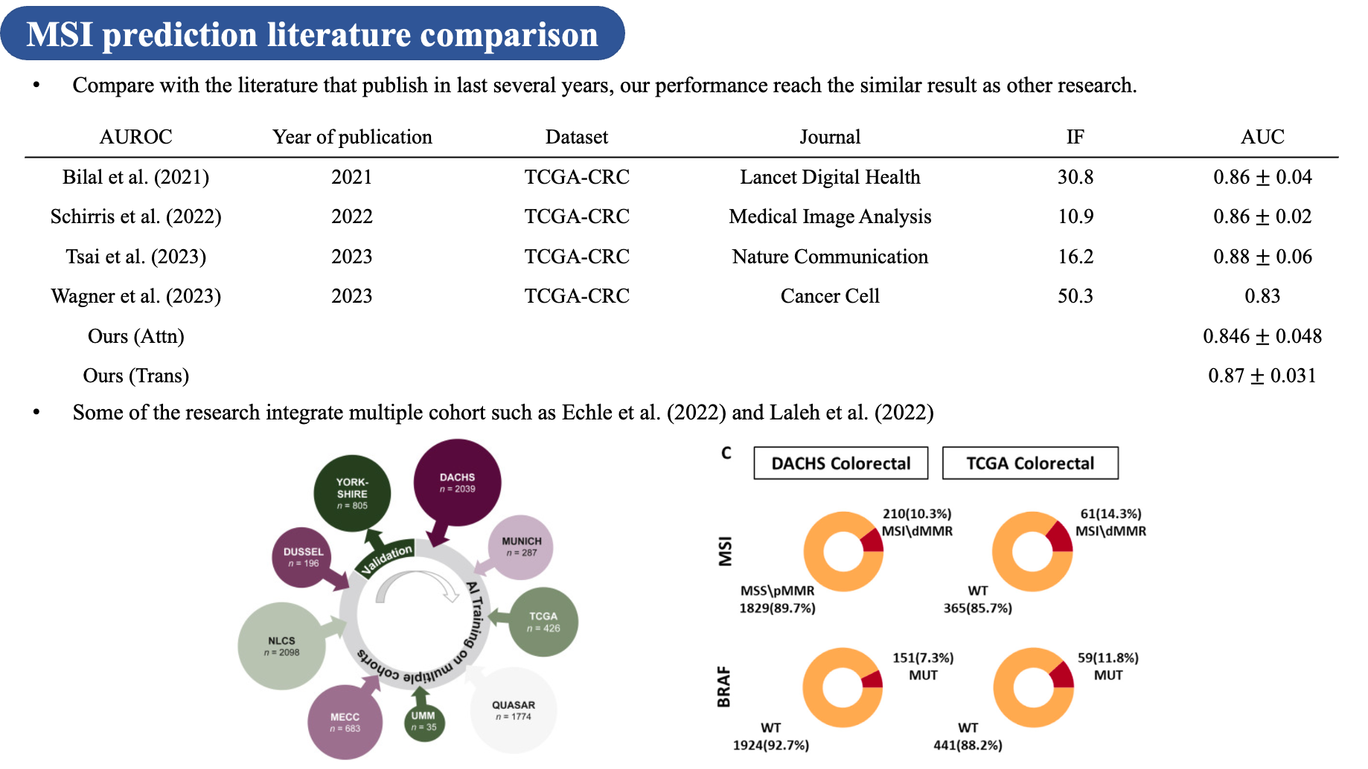

Slide 11
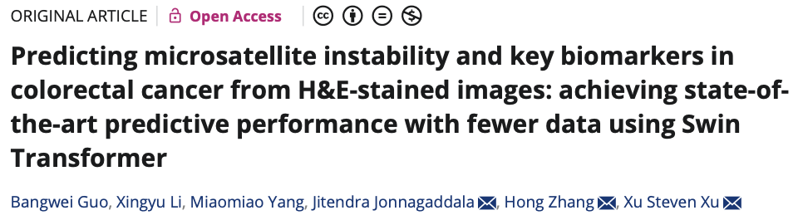
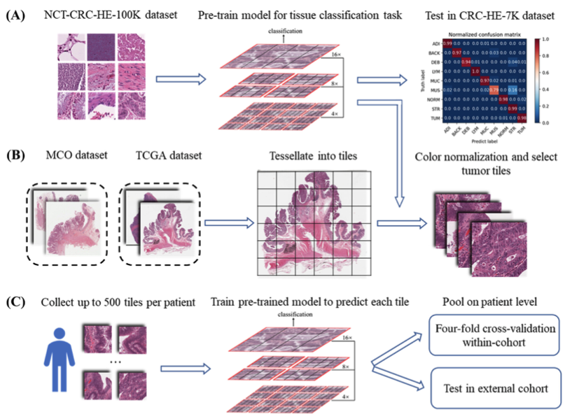
Year of publication: 2023
Journal paper: Journal of Pathology
Impact factor: 7.3
Citation: 7
Cohort: TCGA-COAD + TCGA-READ (TCGA-CRC)
Methods: (A) Tiles images of NCT-CRC-HE-100K are downloaded to pre-train a tissue classifier based on Swin-Transformer. (B) WSIs in the SVS format of the MCO dataset and TCGA dataset are preprocessed to tessellate into nonoverlapping tiles with a size of 512 × 512 pixels. These tiles are then resized to the smaller 224 × 224 pixels tiles and color normalized. The tumor tiles are selected. (C) For each patient, up to 500 tiles are randomly sampled for subsequent experiments. The pre-trained tissue classifier model in (A) is then fine-tuned to predict biomarker status of each tile. The probability values of the tiles are averaged to derive the prediction at the patient level. The performance of the models is evaluated in two separate experiments: an intra-cohort four-fold cross-validation and an inter-cohort external validation.
AUROC | Guo et al. | Ours (Attn) | Ours (Trans)
BRAF | 0.77 ± 0.02 | 0.836 ± 0.027 | 0.894 ± 0.027

Slide 12
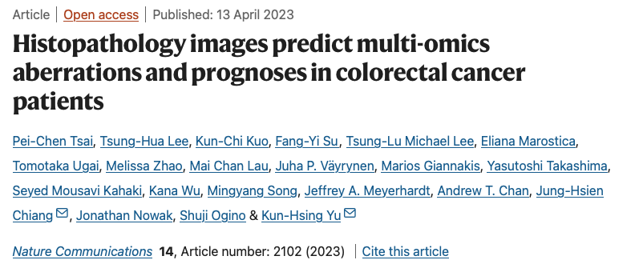
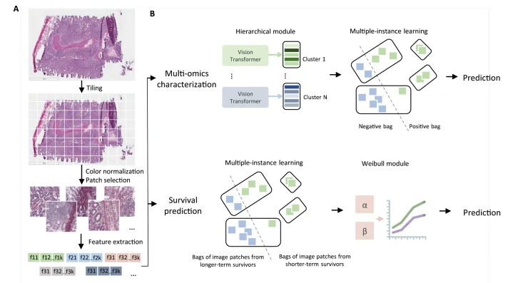
Year of publication: 2023
Journal paper: Nature Communication
Impact factor: 16.2
Citation: 33
Cohort: TCGA-COAD + TCGA-READ (TCGA-CRC)
Methods: A The platform processes the image patches from whole-slide pathology images, normalizes them, and leverages vision transformers to extract image features. B We develop multi-omics characterization and survival prediction frameworks using the extracted image features
AUROC | Tsai et al. | Ours (Attn) | Ours (Trans)
BRAF | 0.71 ± 0.07 | 0.836 ± 0.027 | 0.894 ± 0.027
MSI | 0.88 ± 0.06 | 0.846 ± 0.048 | 0.87 ± 0.031

Slide 13
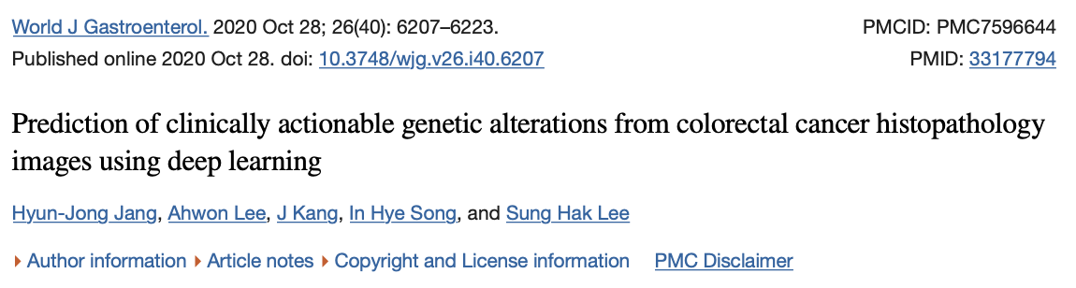
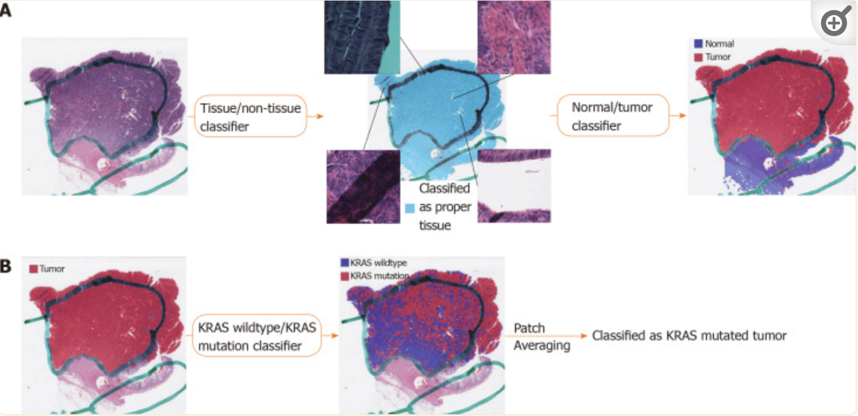
Year of publication: 2020
Journal paper: World Journal of Gastroenterology
Impact factor: 4.3
Citation: 47
Cohort: TCGA-COAD + TCGA-READ (TCGA-CRC)
Methods: (A) Proper tissue patches can be selected by the tissue/non-tissue classifier. Then, the normal/tumor classifier delineates the tumor patches among the proper tissue patches; (B) The wild-type/mutation classifiers are applied only for patches with tumor probability higher than 0.9. The patch-level probabilities of mutation are averaged to yield the slide-level probability.
AUROC | KRAS
Jang et al. (Frozen) | 0.778
Jang et al. (FFPE) | 0.645
Ours (Attn) | 0.636 ± 0.055
Ours (Trans) | 0.61 ± 0.045

Slide 14
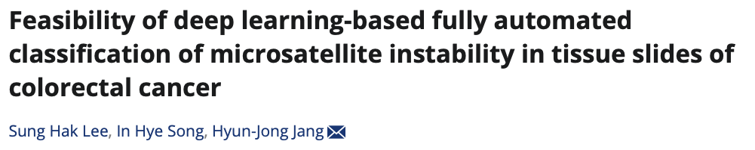
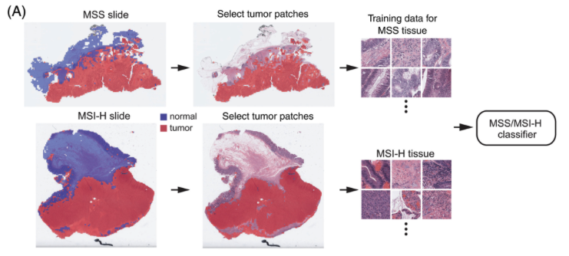
Year of publication: 2021
Journal paper: Journal of Cancer
Impact factor: 3.9
Citation: 44
Cohort: TCGA-COAD + TCGA-READ (TCGA-CRC)
Methods: (A) Proper tissue patches can be selected by the tissue/non-tissue classifier. Then, the normal/tumor classifier delineates the tumor patches among the proper tissue patches; (B) The MSS/MSI-H classifiers are applied only for patches with tumor probability higher than 0.9. The patch-level probabilities of mutation are averaged to yield the slide-level probability.
AUROC | MSI
Lee et al. (Frozen) | 0.942
Lee et al. (FFPE) | 0.861
Ours (Attn) | 0.846 ± 0.048
Ours (Trans) | 0.87 ± 0.031

Slide 15
Year of publication: 2020
Journal paper: World Journal of Gastroenterology
Impact factor: 4.3
Citation: 47
Cohort: TCGA-COAD + TCGA-READ (TCGA-CRC)
Methods: (A) Proper tissue patches can be selected by the tissue/non-tissue classifier. Then, the normal/tumor classifier delineates the tumor patches among the proper tissue patches; (B) The wild-type/mutation classifiers are applied only for patches with tumor probability higher than 0.9. The patch-level probabilities of mutation are averaged to yield the slide-level probability.
Both KRAS and MSI prediction shows that the performance of frozen tissue is higher than FFPE
We can separate frozen and FFPE slides and train it respectively
AUROC | KRAS
Jang et al. (Frozen) | 0.778
Jang et al. (FFPE) | 0.645
Ours (Attn)
Ours (Trans)

Slide 16
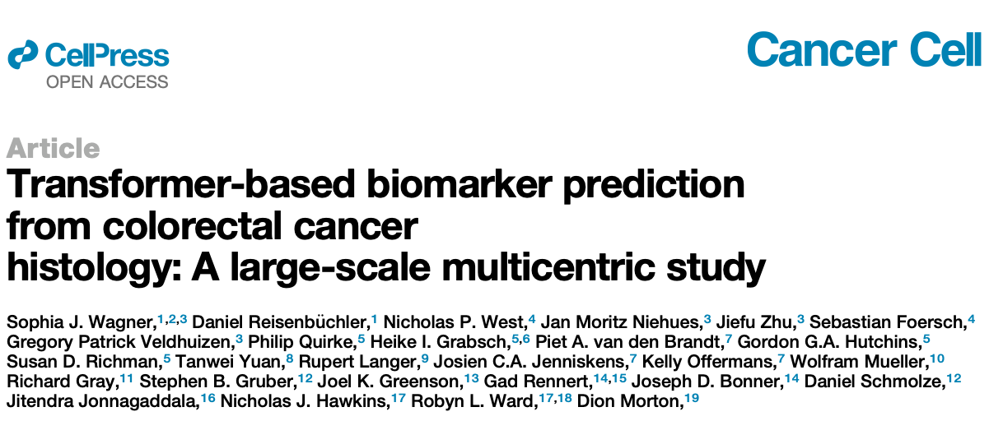
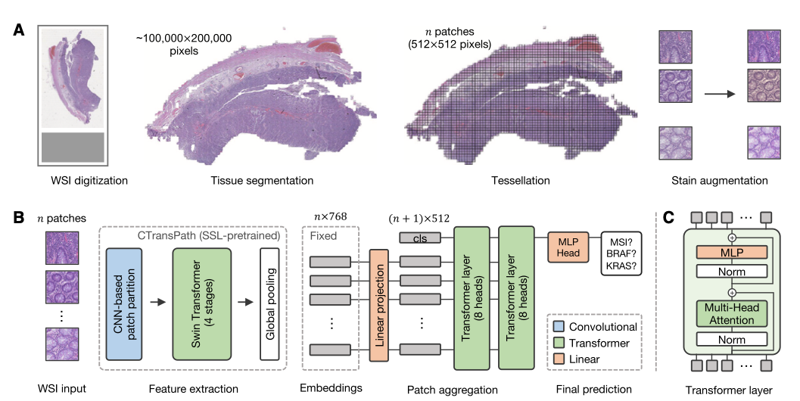
Year of publication: 2023
Journal paper: Cancer Cell
Impact factor: 50.3
Citation: 43
Cohort: TCGA-COAD + TCGA-READ (TCGA-CRC)
Methods: (A) The data pre-processing pipeline with the steps whole slide image (WSI) digitization, tissue segmentation, WSI tessellation into patches, and stain augmentation, (B) the model architecture including the pre-trained feature extractor CTransPath and our transformer-based aggregation module, and (C) details of the transformer layer architecture.
AUROC | MSI
Lee et al. (Frozen) | 0.942
Lee et al. (FFPE) | 0.861
Ours (Attn) | 0.846 ± 0.048
Ours (Trans) | 0.87 ± 0.031

Slide 17
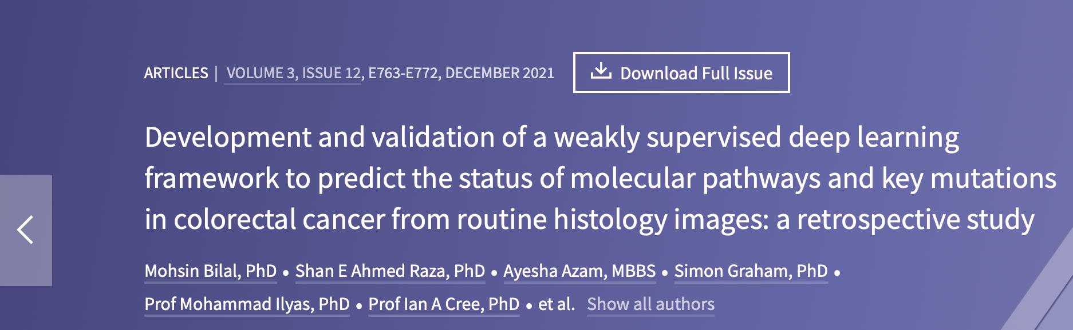
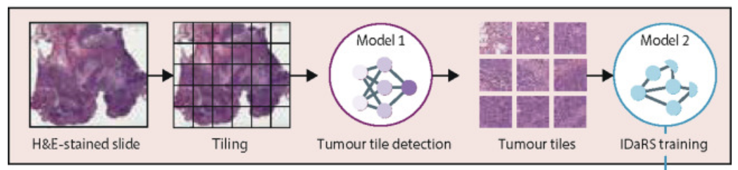
Year of publication: 2021
Journal paper: Lancet Digital Health
Impact factor: 30.8
Citation: 152
Cohort: TCGA-COAD + TCGA-READ (TCGA-CRC)
Methods: Model 1 (ResNet18) was trained to separate tumor from non-tumor tiles. These tiles served as input to iterative draw and rank sampling (an adaptation of ResNet34; model 2), which was trained on tumor tiles for label prediction.
AUROC | Bilal et al. | Ours (Attn) | Ours (Trans)
BRAF | 0.79 ± 0.01 | 0.836 ± 0.027 | 0.894 ± 0.027
KRAS | 0.6 ± 0.04 | 0.636 ± 0.055 | 0.61 ± 0.045
MSI | 0.86 ± 0.04 | 0.846 ± 0.048 | 0.87 ± 0.031

Slide 18
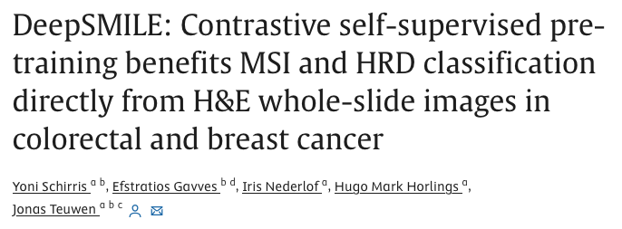
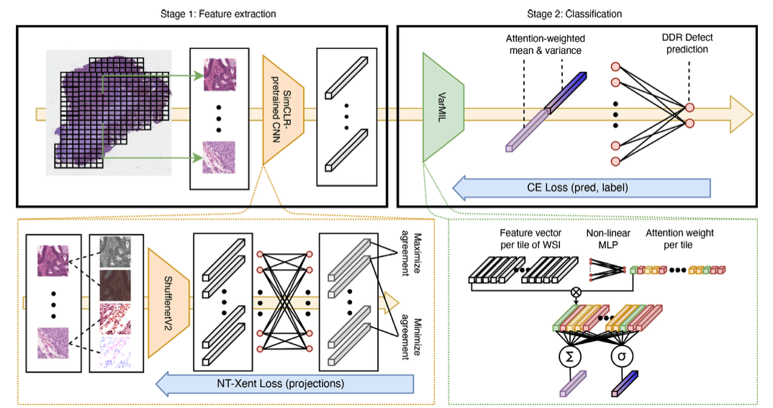
Year of publication: 2022
Journal paper: Medical Image Analysis
Impact factor: 10.9
Citation: 68
Cohort: TCGA-COAD + TCGA-READ (TCGA-CRC)
Methods: We extract all non-background tiles from a WSI, and from each tile extract the latent feature vector using a domain-specific feature extractor pre-trained with SimCLR. VarMIL computes the attention-weighted mean and variance of all tile latent feature vectors. The concatenated mean and variance are passed to a linear classification layer to compute the WSI-level genomic label classification.
AUROC | MSI
Schirris et al. | 0.86 ± 0.02
Ours (Attn) | 0.846 ± 0.048
Ours (Trans) | 0.87 ± 0.031

Slide 19
Thesis outline
Chapter 1. Introduction
1.1 Colon Adenocarcinoma
1.2 Generalizable Biomarker for Colon Cancer
1.2.1 BRAF
1.2.2 KRAS
1.2.3 Microsatellite Instability
1.3 Biomarker Screening
1.4 Digital Pathology
1.5 Literature Review
1.6 Artificial Intelligence
1.6.1 Machine Learning
1.6.2 Deep Learning
1.6.2.1 Deep Neural Network
1.6.2.2 Convolutional Neural Network
1.6.2.3 Loss Function
1.6.2.4 Optimization
1.6.3 Self-supervised Learning
1.6.4 Multiple Instance Learning
1.6.5 MIL Attention Mechanism
1.6.6 Self-attention Mechanism
1.7 Specific Aims

Slide 20
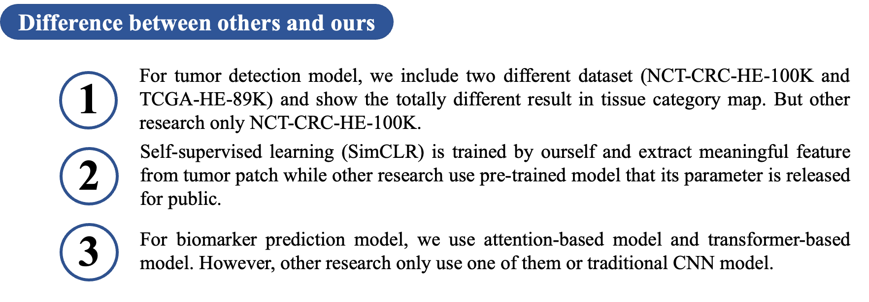

Slide 21
Future works
1
Write introduction, materials & methods (thesis)
2
Keep improve performance

